Slide 1
Unit5
Daniel Byrne
9/24/2019
Slide 1: Use Aic5 to assess the use of ARMA models in the Walmart data.
aic5.wge(Stor9Item50$sales)
## ---------WORKING... PLEASE WAIT... ## ## ## Five Smallest Values of aic
## p q aic ## 15 4 2 4.991650 ## 17 5 1 5.009865 ## 18 5 2 5.021469 ## 14 4 1 5.073902 ## 12 3 2 5.114417

Slide 2
Slide 2: Find p1 for the following model by hand. Xt = at–.8at-1 + .5at–2.
theta1 = .8 theta2 = -.5 p1 = (-theta1 + theta1*theta2)/(1 + theta1^2 + theta2^2) p1
## [1] -0.6349206

Slide 3
Slide 3: Represent the model as a GLP.
Xt = at–.8at-1 + .5at–2

Slide 4
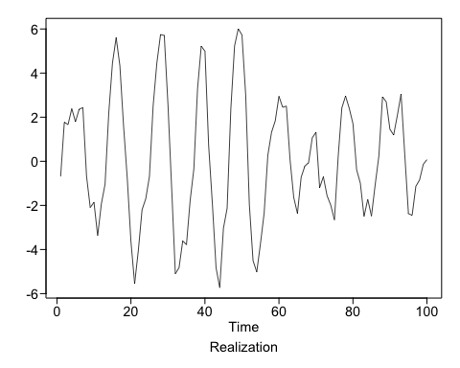
Slide 4: Generate a realizations from an ARMA model. pick p and q. Include the ACF and spectral density.
gen.arma.wge(n=100, phi=c(1.6,-.9), theta=.8, vara=1, plot=TRUE)

Slide 5
Slide 5: Use AIC 5 to identify the top five quality models with respect to AIC for the cancelled flight data from the SWADelay.csv data set (column: arr_cancelled). Comment on which are AR, MA, and ARMA.
row 1 AR Model
row 2 MA Model
row 3 AR Model
row 4 ARMA Model
row 5 MA Model
aic5.wge(swadelay$arr_cancelled)
## ---------WORKING... PLEASE WAIT... ## ## ## Five Smallest Values of aic
## p q aic ## 4 1 0 7.371886 ## 3 0 2 7.376428 ## 7 2 0 7.381147 ## 5 1 1 7.381751 ## 2 0 1 7.386961

Slide 6
Take Aways
ARMA models are identical to IIF and FIR filters in Signal Processing Terminology
https://www.johndcook.com/blog/2017/10/20/time-series-analysis-vs-dsp-terminology-ma-arma-fir-iir/

